Slide 1
Deep learning for Knee Bone Segmentation
Ian Carvalho, Dishant Desai

Slide 2
Introduction
Medical Image Segmentation
Hard to obtain data
Better accuracy than humans
Liability Concerns
Unet
Fully Convolutional Network
Downsampling: Convolutional Pooling
Upsampling
No Dense Layer
Generated prediction

Slide 3
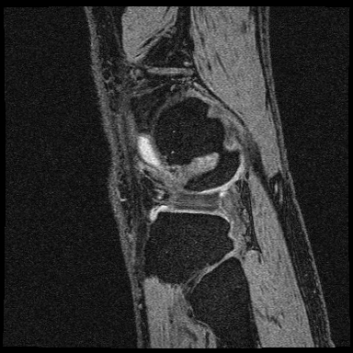

Dataset

Slide 4
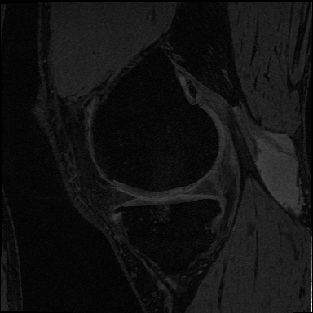
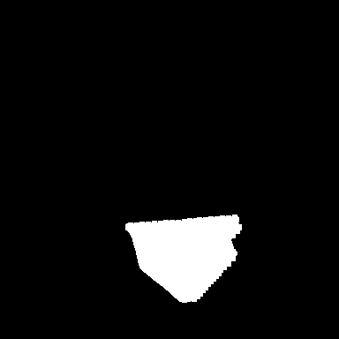
Dataset

Slide 5
Methodology
Manual Labeling
Loading dataset
Standardization
(Data Augmentation)
Training - Unet Model
Early Stopping
Evaluation - Dice

Slide 6
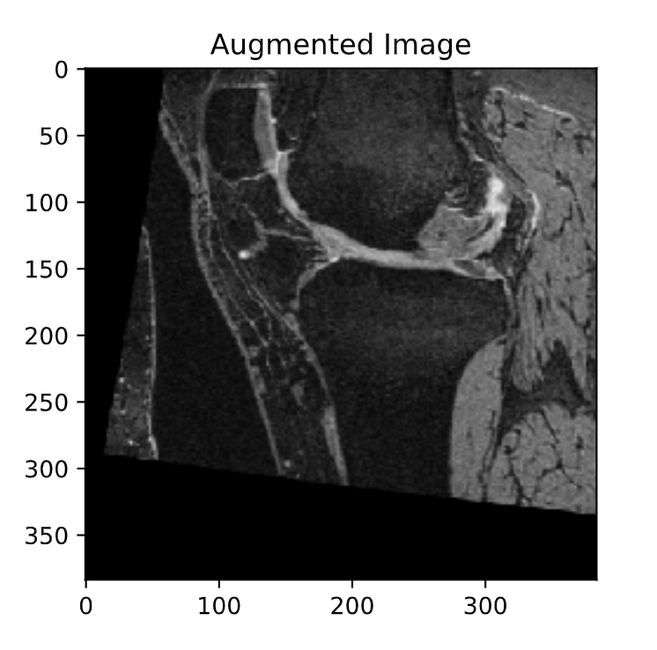
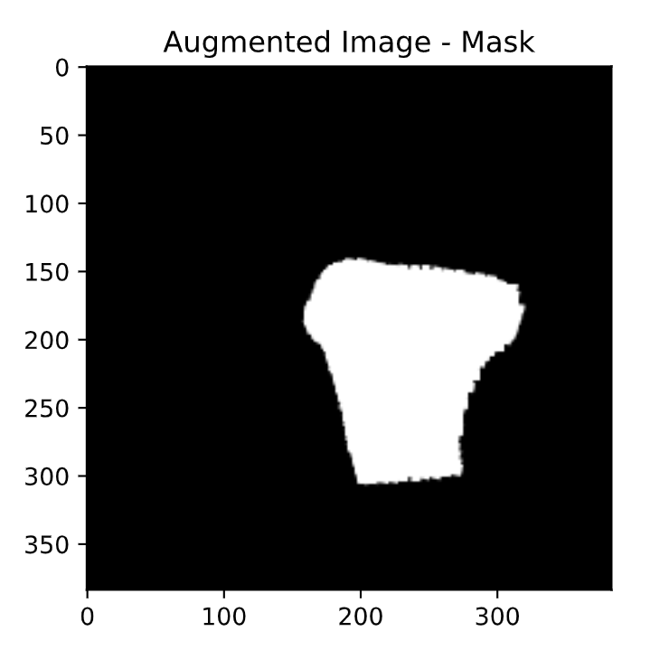
Data Augmentation

Slide 7
Experiments
Group dataset
Size - Training: 665
Size - Test: 198
Class dataset
Size - Training: ~2.900
Size - Test: ~900
Augmented dataset
Size - Training: ~5.800
Size - Test: ~900

Slide 8
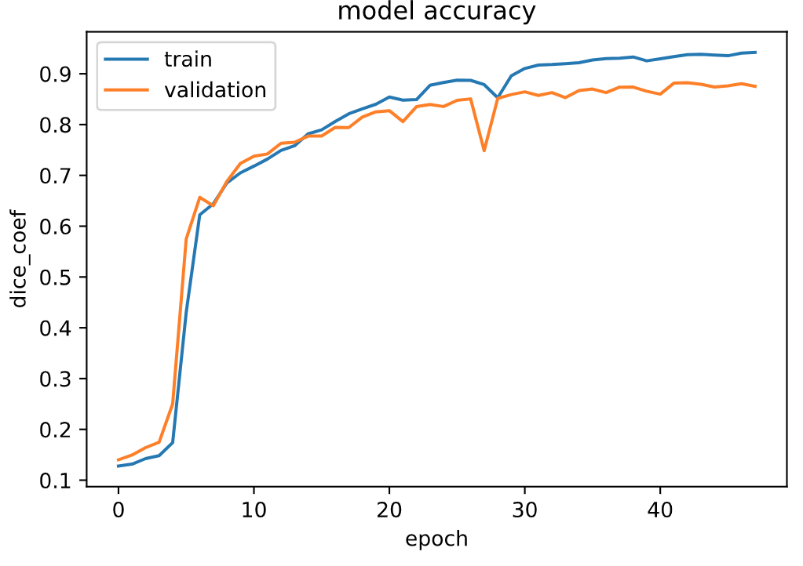
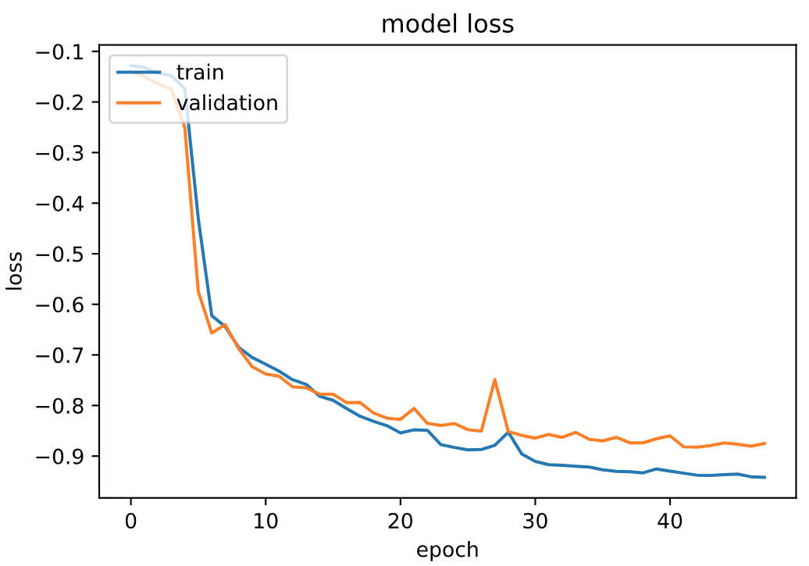
Training History - Group dataset
Notes:
Loss = difference between prediction and the expected labelings. The smaller the better

Slide 9
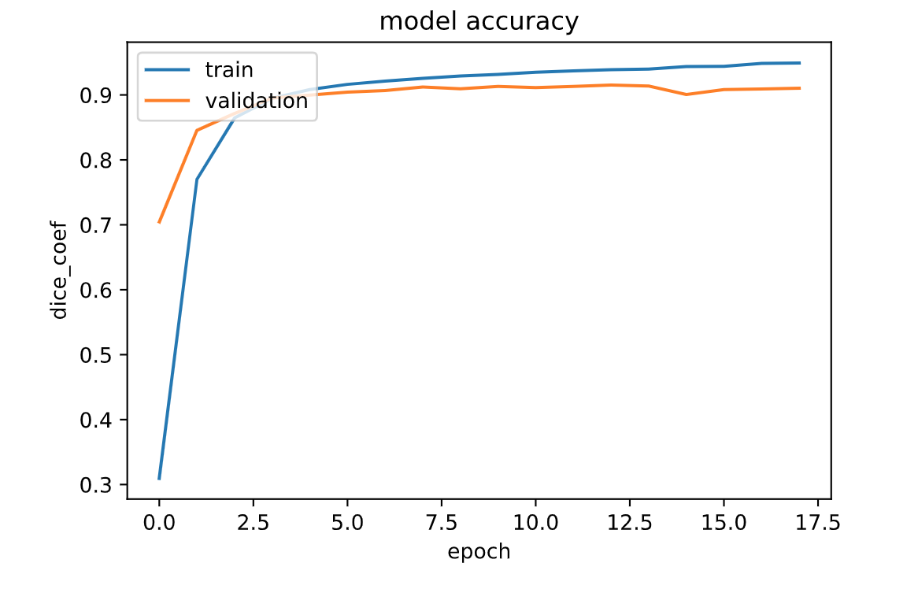
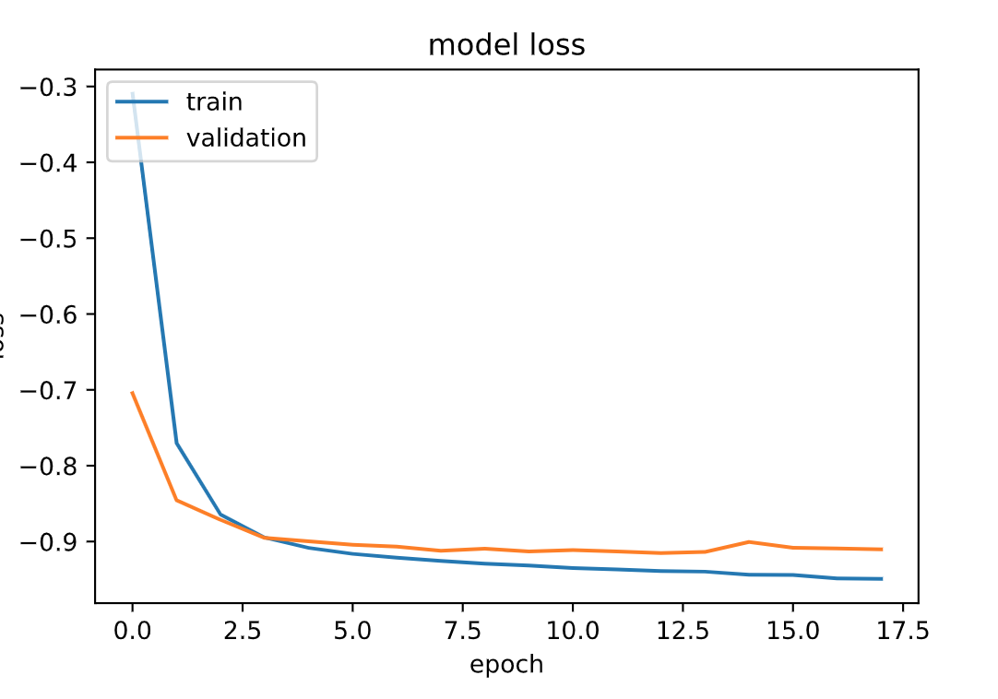
Training History - Class dataset

Slide 10
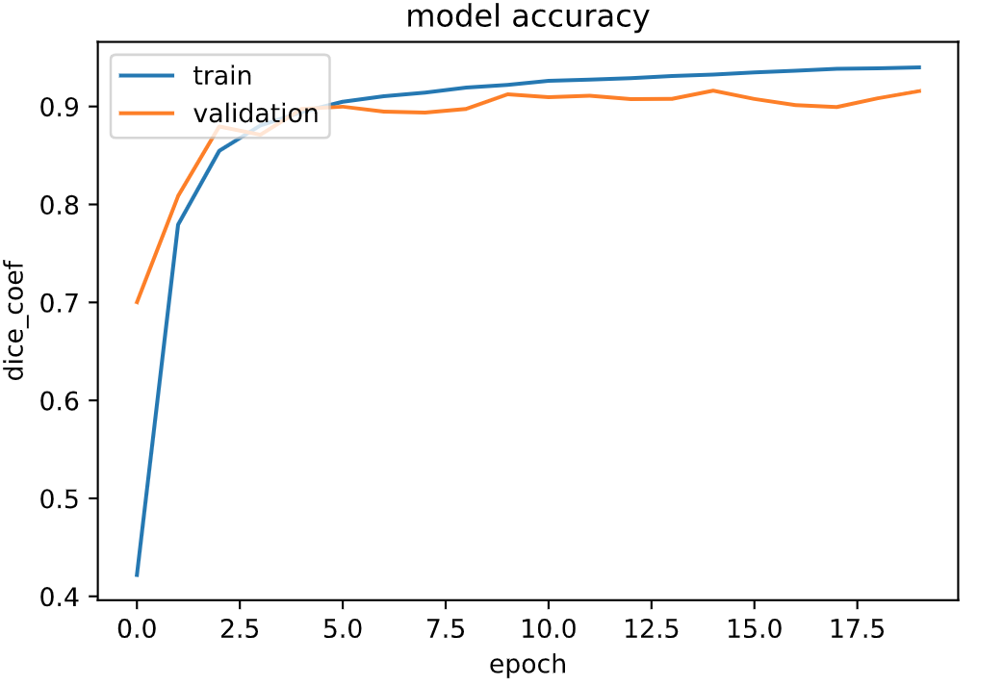
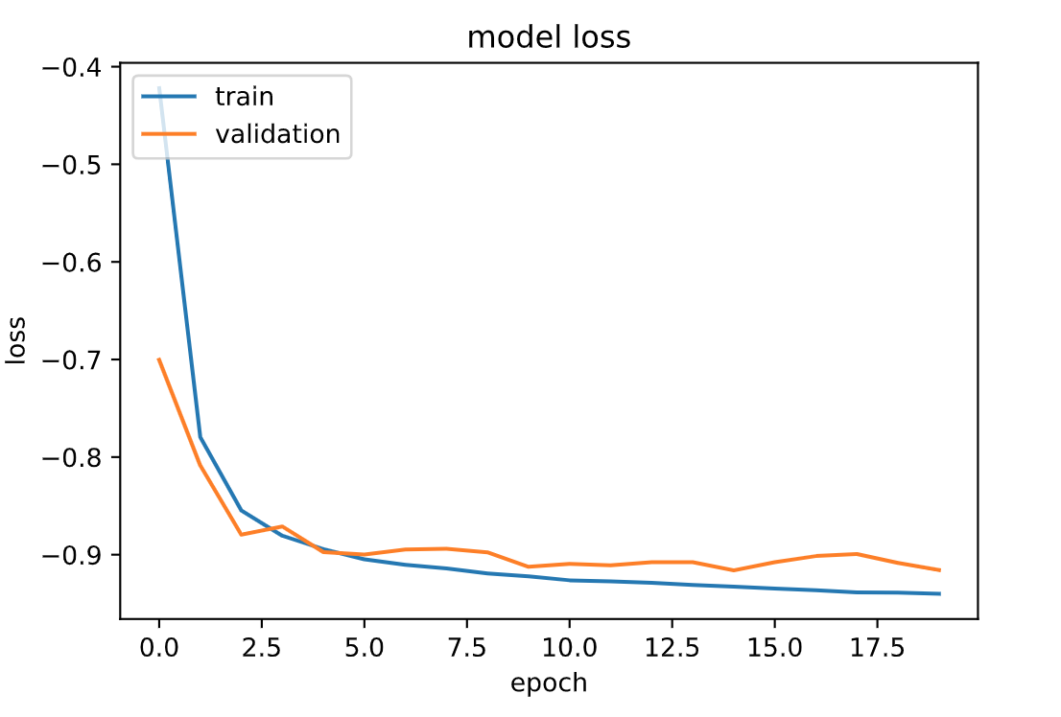
Training History - Augmented dataset

Slide 11
Results
Group dataset
Epochs: 41
Training Score: 0.926
Validation Score: 0.884
Test Score: 0.898
Class dataset
Epochs: 15
Training Score: 0.932
Validation Score: 0.915
Test Score: 0.903
Augmented dataset
Epochs: 15
Training Score: 0.932
Validation Score: 0.916
Test Score: 0.905

Slide 12
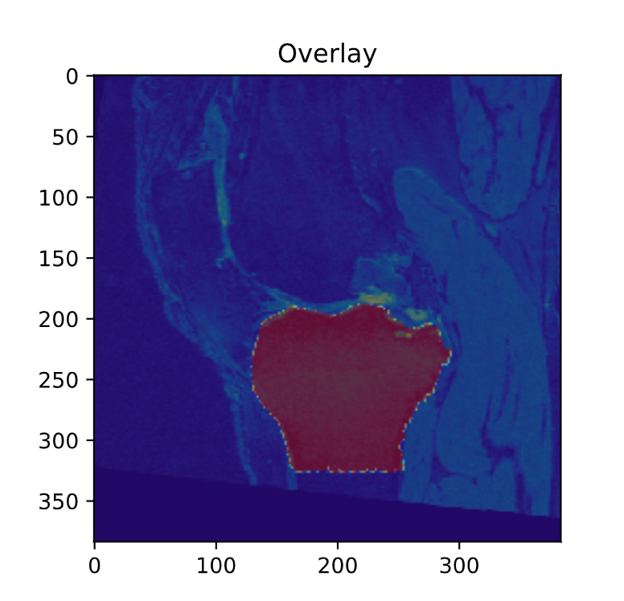
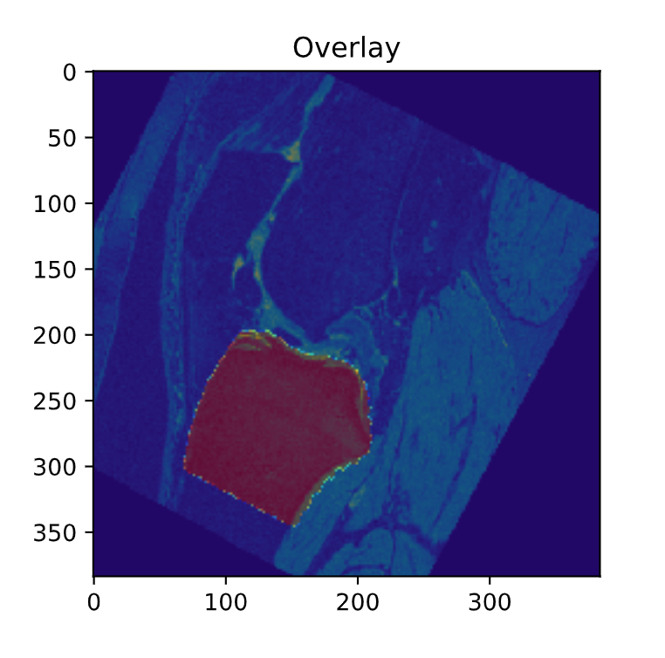
Results

Slide 13
Conclusion
Able to accurately segment the bone
Large Dataset = Better Performance
Tuning Hyperparameters could impact performance
Notes:
Hyperparameters: early stopping, batch size, learning rate

